Slide 1

Hardware Debugging

Slide 2
Debugging
The Efinity software includes a hardware Debugger to probe signals in your FPGA design via the JTAG interface.
The Debugger has two perspectives:
Profile Editor and Debug. The Profile Editor perspective is where you add debug cores manually.
You can also view the settings of a Logic Analyzer core that you created with the Debug Wizard.
The Debug perspective is where you perform debugging.

Slide 3
Debugging
The Debugger includes two debug cores, Virtual I/O (vio) and a Logic Analyzer (la). You use a manual flow and the Profile Editor to configure Virtual I/O cores or the Debug Wizard's automated flow to configure Logic Analyzer cores.
Debugging involves the following general steps:
Create a debug profile with the Virtual I/O and/or Logic Analyzer debugger core(s).
Generate the debug design file and add it to your project.
Compile.
Program the FPGA.
Run the Debugger GUI and observe the values on the probes.

Slide 4

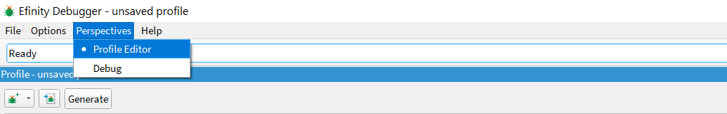
Profile Editor Perspective
Open Debugger from toolbar.
Choose Perspectives > Profile Editor to open the editor.
If you created a debug profile using the Debug Wizard, the editor loads it automatically. You can import an existing profile; if you do not have an existing debug profile, you add Virtual I/O or Logic Analyzer cores and then configure them.

Slide 5
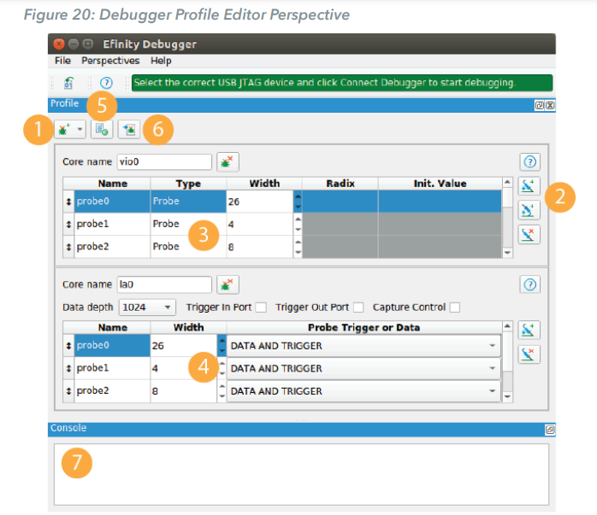
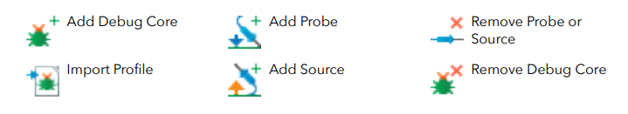
Click Add Debug Core to add a Logic Analyzer (la) or Virtual I/O (vio) core manually. You can also use the Debug Wizard for Logic Analyzer cores.
For vio, add probes and sources; for la, add probes.
For vio, specify the signal name and width; for sources you can also specify a radix and initial value.

Slide 6
For la, specify the signal name, width, and whether the signal is for collecting data, triggering, or both.
Click Generate Core RTL to create the debug module and instantiation template
If you created a debug profile with the Debug Wizard, click Import Profile to load it.
The Console displays messages.

Slide 7
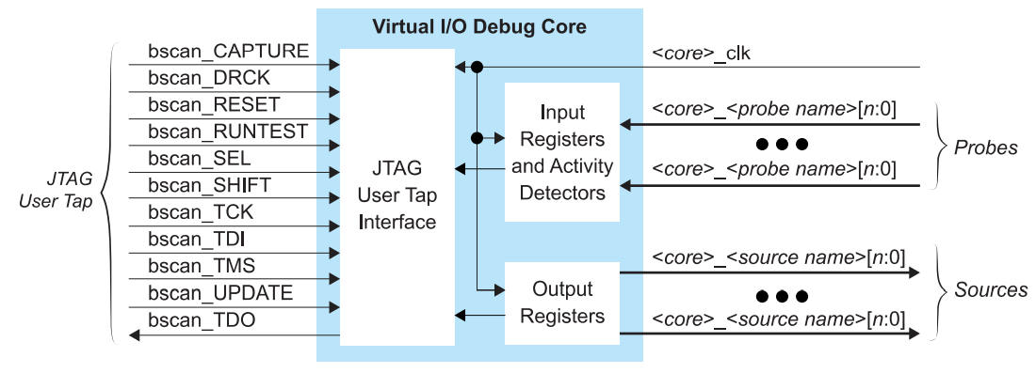
Virtual I/O Debug Core
The Virtual I/O (vio) core lets you monitor and drive the FPGA signals using the Debugger. You can use it to capture instantaneous data from connected wires or registers, and you can edit values of connected wires or register. This debug core is useful for triggering reset or control signals in real time.

Slide 8
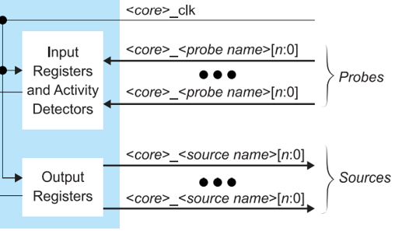
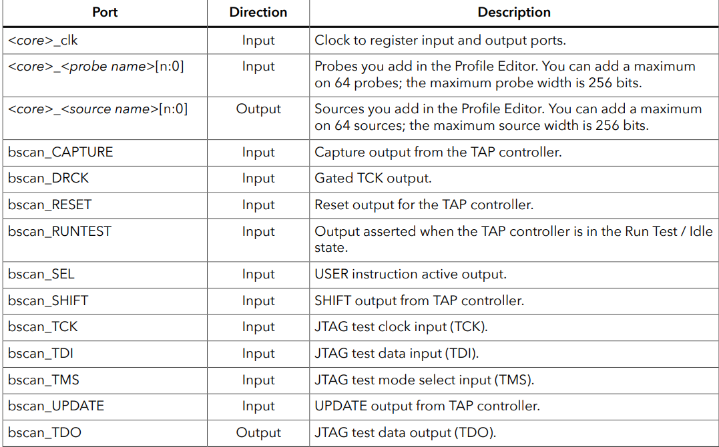
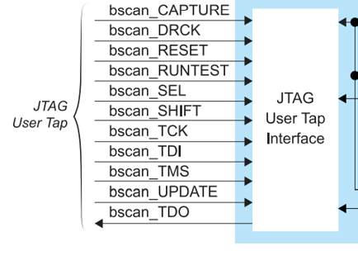

Slide 9
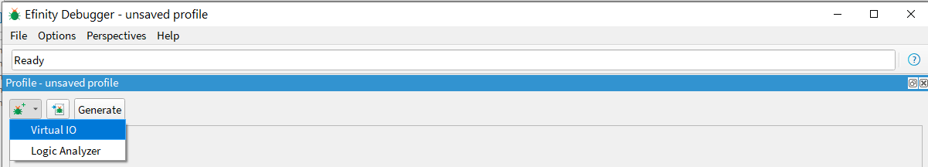
Adding a Virtual I/O Core
Open the Debugger.
Choose Perspectives > Profile Editor.
Choose Add Debug Core > VIO.

Slide 10
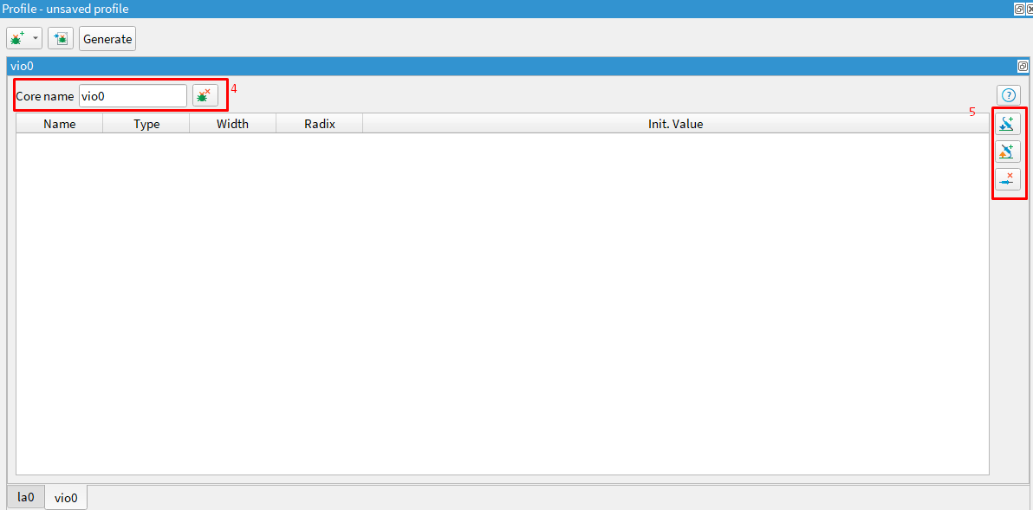



Specify the core name.
Add sources (inputs to your design from the JTAG interface) and probes (outputs from your design to the JTAG interface).
Add Probe Add Source Remove Probe/Source

Slide 11
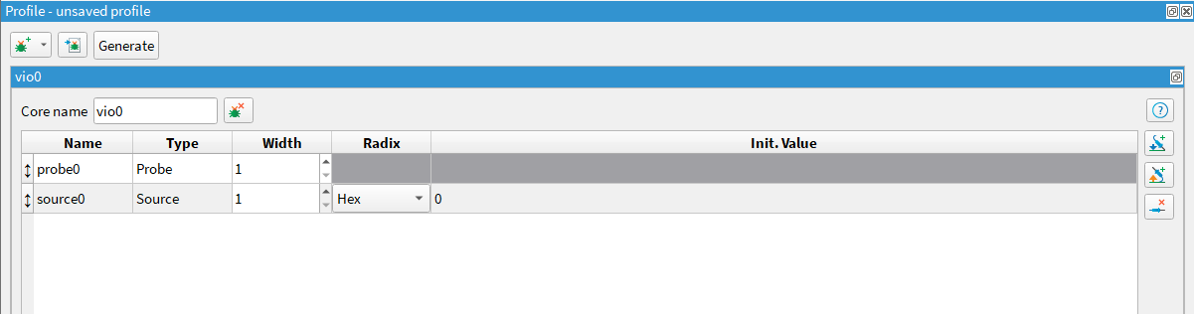
• For probes, choose a width and specify the signal to which you want to connect the probe in your design.
• For sources, choose a width and specify the signal to which you want to connect the source in your design; you can set an initial value and choose a radix for how to display the data

Slide 12
Adding a Virtual I/O Core cont’d
Click Generate Core RTL. The Efinity software saves the debug profile in your project directory as debug_profile.json. The software also creates a debug template (debug_TEMPLATE.v), which includes the module for the debug profile you created and debug_top.v, which is the RTL logic for the debug core.
Add the ‘debug_top.v’ file to your project.
Add a JTAG User Tap block in the Interface Designer. Choose JTAG_USER2 as the JTAG Resource.

Slide 13
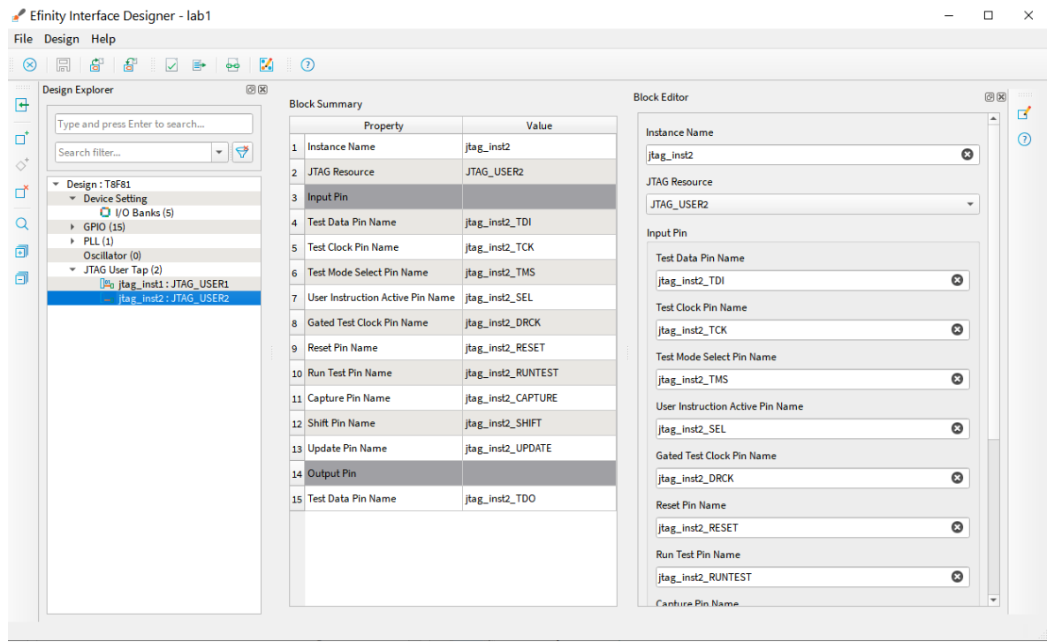
Add the debug logic into your design using these steps:
Add all of the JTAG input and output pins to the project's top module. Refer to the JTAG User TAP block pin names in the Interfaces Design to get the pin list.

Slide 14
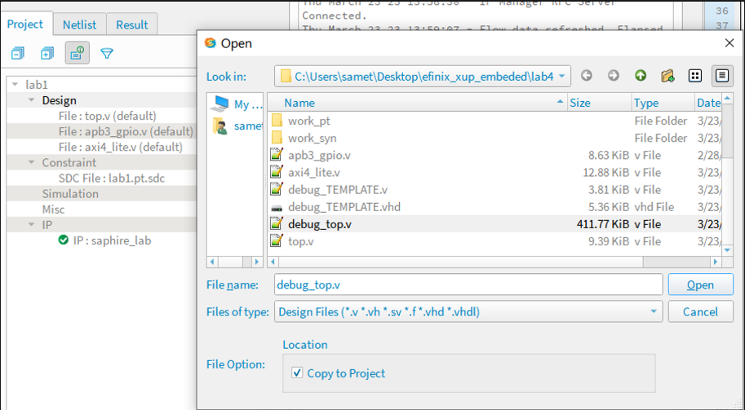
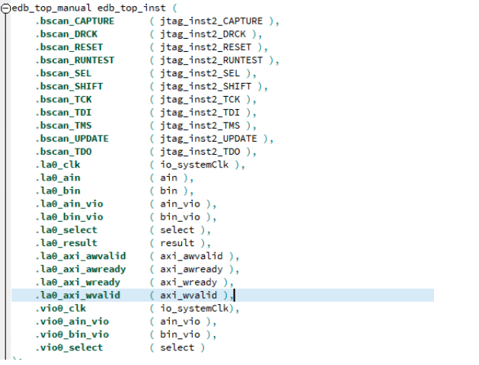
Instantiate the debug core in the project's top module. You can copy the example code from the generated debug_TEMPLATE.v or debug_TEMPLATE.vhd file in the project folder.
Connect the nets that you want to monitor and drive the FPGA signals. You need to map the net (input, output, wire, register, and/or signal) to the port of the instantiated debug core (edb_top_inst).
Compile the design.

Slide 15
Logic Analyzer Debug Core
You use the Logic Analyzer core (la) to monitor the signals in your design. You can capture connected wire or register values over a specified time period. During runtime, the core samples the signals and saves the data into the FPGA's block RAM. You can specify the number of probes, the buffer depth, and the width for each probe input. Additionally, you can set global AND, OR, NAND, and NOR trigger conditions as well as segment triggers.
You add a Logic Analyzer core manually or using the Debug Wizard, compile your design, and program the FPGA. Then, you use the Debugger to set trigger events. When a trigger occurs, the core fills the sample buffer and loads the results into the Debugger's Debug Perspective. You can view this data using the GTK waveform viewer.

Slide 16
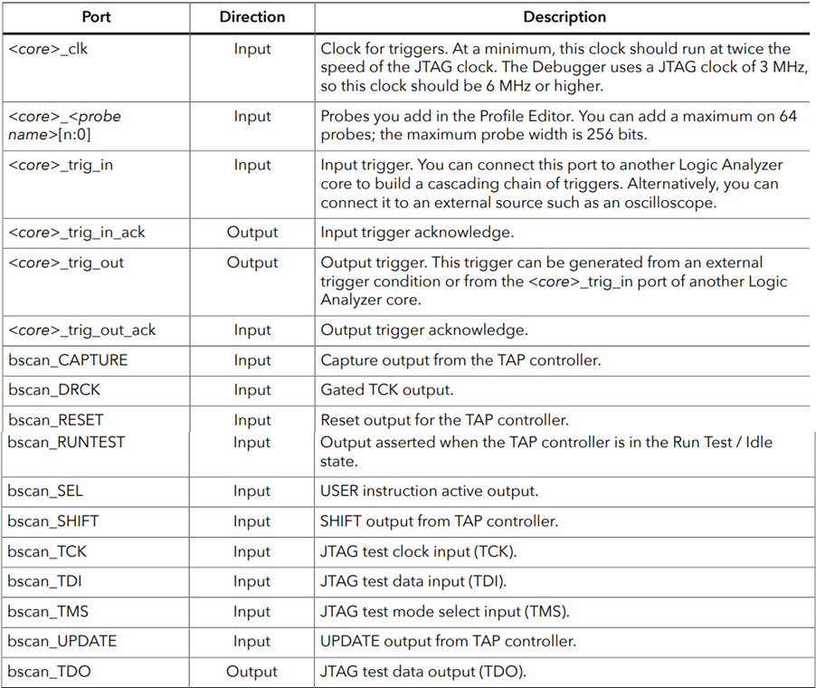
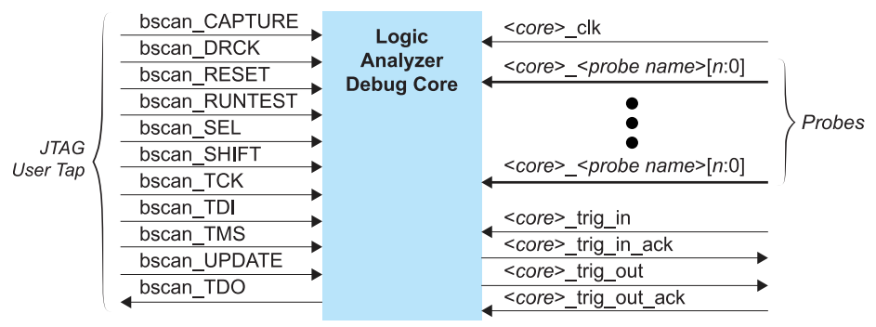
Logic Analyzer Debug Core

Slide 17
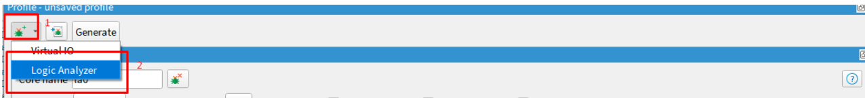
Adding a Logic Analyzer Core Manually
Open the Debugger.
Choose Perspectives > Profile Editor.
Choose Add Debug Core > Logic Analyzer.

Slide 18
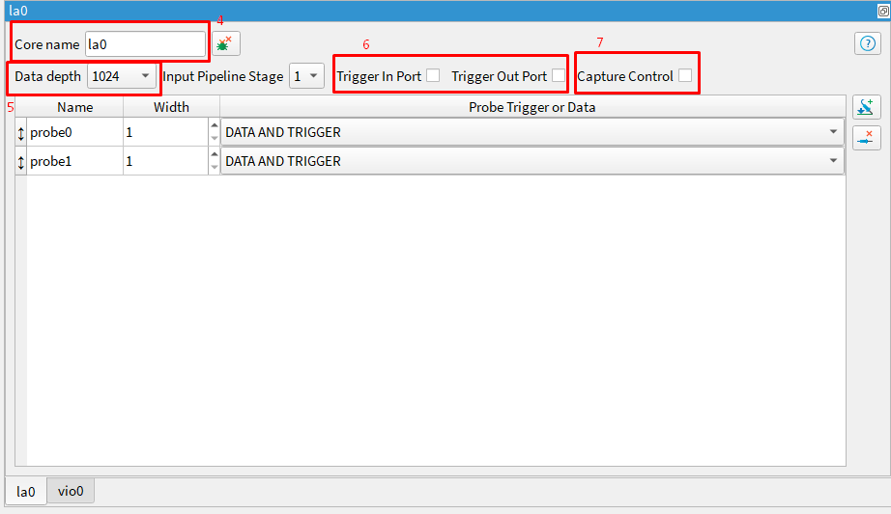
Specify the core name.
Select the data depth. This settings lets you control how much data is saved for the probes. The more data you save, the more on-chip memory is used.
Turn on Trigger In Port and/or Trigger Out Port to enable those signals.
Turn on Capture Control if you want to change the capture mode in the Capture Setup tab during debugging. If you turn this option on, the Logic Analyzer uses more FPGA resources.

Slide 19
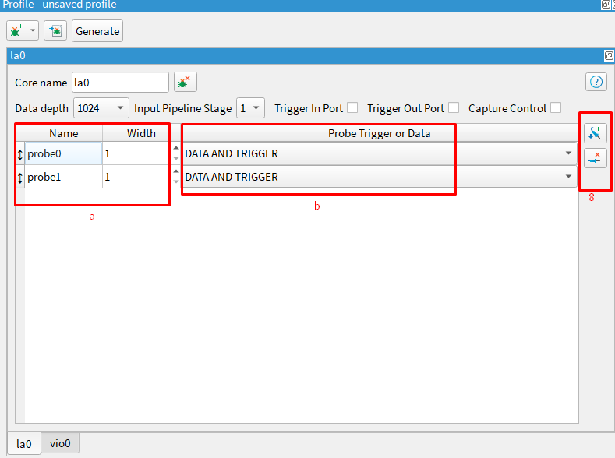


Add probes (outputs from your design to the JTAG interface).
Choose a width and specify the signal to which you want to connect the probe in your design.
Choose Data and Trigger (default) to save data and can trigger when to capture. Choose Data Only to save data. Choose Trigger Only to trigger when to capture data. Tigger only signals do not display in the resulting waveform.
Add Probe Remove Probe

Slide 20
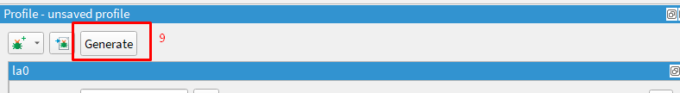
Adding a Logic Analyzer Core Manually
Click Generate Core RTL. The Efinity software saves the debug profile in your project directory as debug_profile.json. The software also creates a debug template (debug_TEMPLATE.v), which includes the module for the debug profile you created and debug_top.v, which is the RTL logic for the debug core.
Add the debug_top.v file to your project.
Add a JTAG User Tap block in the Interface Designer. You can choose either JTAG resource

Slide 21
Add the debug logic into your design using these steps:
Add all of the JTAG input and output pins to the project's top module. Refer to the JTAG User TAP block pin names in the Interfaces Design to get the pin list.

Slide 22
Adding a Logic Analyzer Core Manually cont’d
Instantiate the debug core in the project's top module. You can copy the example code from the generated debug_TEMPLATE.v or debug_TEMPLATE.vhd file in the project folder.
Connect the nets that you want to monitor and drive the FPGA signals. You need to map the net (input, output, wire, register, and/or signal) to the port of the instantiated debug core (edb_top_inst).
Compile the design.

Slide 23
Debug Wizard
The Debug Wizard provides an automated flow for adding a logic analyzer core to your design.
You launch the wizard from the Efinity main icon bar. This wizard is helpful for complex projects with multiple levels of hierarchy.
You select signals and nets from the post-map netlist and specifiy the probe type. Then, the wizard automatically creates a debug profile, adds the debug core to your project, connects the nets that you want to debug to the probe ports of the debug instance, and adds the JTAG User Tap block to your interface design.
When the wizard completes its processing, you simply compile and start debugging.

Slide 24
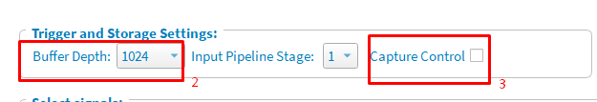
Using the Wizard
Launch the Debug Wizard.
Choose the buffer depth. The buffer uses on-chip RAM, therefore, a larger buffer uses more RAM.
Optionally enable capture control. Enabling this option lets you change the capture mode in the Capture Setup tab during debugging .If you turn this option on, the logic analyzer uses more FPGA resources.

Slide 25
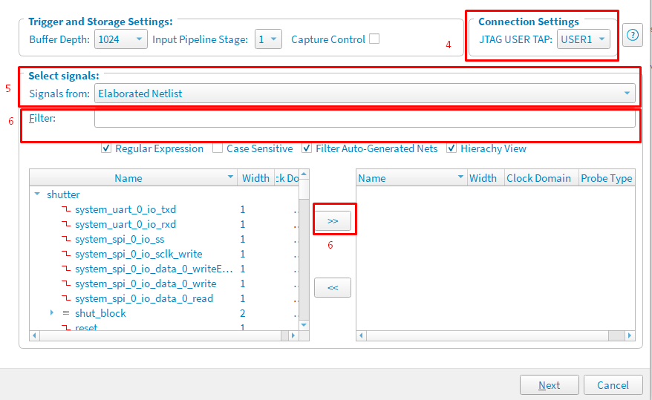
Select the JTAG User TAP (USER1 or USER2) to connect to the Debugger in the Connection Settings box.
In the Signals from list, choose Elaborated Netlist to browse for signals in the pre-map netlist, or Post-Map to use signals from the post-map netlist.
Select signals and add them using the forward arrows. You can filter the signal list with regular expressions.

Slide 26
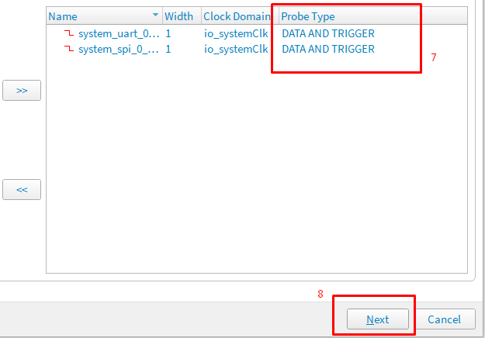
Using the Wizard cont’d
Specify the probe type (Data and Trigger, Data Only, or Trigger Only) for each signal.
Click Next. The wizard generates the core and hooks it up to your design.

Slide 27
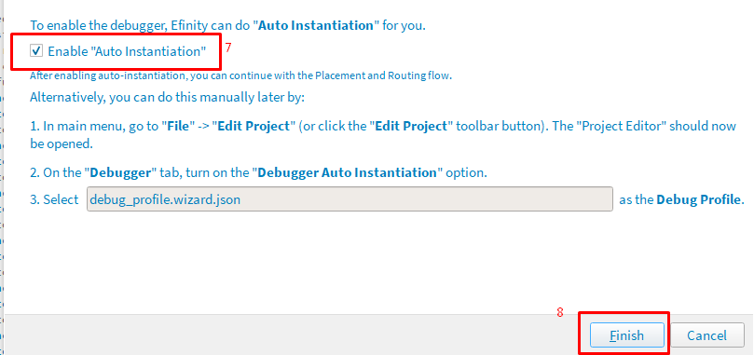
Turn on Enable Auto Instantiation to have the wizard enable the logic analyzer in your project.
Click Finish. The Efinity software saves the debug profile in your project directory as debug_profile.wizard.json. The software also creates a debug template (debug_TEMPLATE.v), which includes the module for the debug profile you created and debug_top.v, which is the RTL logic for the debug core.

Slide 28
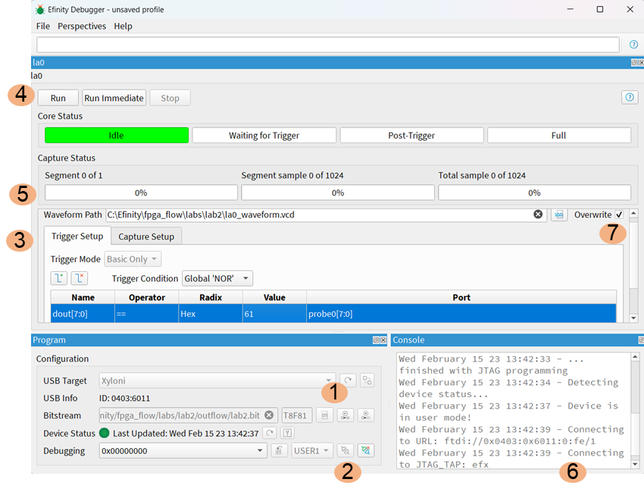
Debug Perspective: Logic Analyzer
The Debug perspective is where you perform debugging. From this view, you can program the FPGA, set triggers, and open the GTKWave waveform viewer to see the results. The following figure shows the Debug perspective for the Logic Analyzer.
Select the bitstream and program the FPGA
Connect the Debugger.

Slide 29
Debug Perspective: Logic Analyzer
Add triggers. If you turned on Capture Control in the Debug Wizard, you can adjust the capture mode in the Capture Setup tab.
Click Run to run the code. The Debugger waits for the trigger conditions you set and then captures data. Click Run Immediate to begin capturing data immediately.

Slide 30
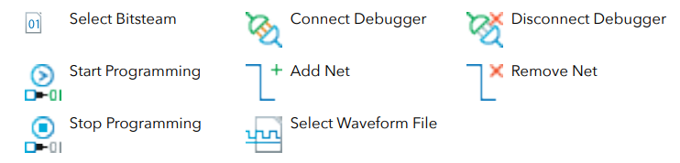
Debug Perspective: Logic Analyzer
The Core status and Capture status areas show the progress.
The Console shows messages.
Click the Select Waveform File button to choose a waveform file.

Slide 31
Understanding Capture Control
The Logic Analyzer core supports a capture control option. When you turn on this option in
the debug profile, the Capture Setup tab becomes available during debugging.
The Capture Mode option selects which condition the Debugger evaluates before each
sample is captured:
Always—Stores a data sample during a given clock cycle regardless of any capture conditions you set.
Basic—Only stores a data sample during a given clock cycle if the capture condition evaluates as true. Select this option to add nets and set capture conditions. You can subdivide the capture data buffer into one or more segments. The Debugger automatically suggests a window depth depending on the number of segments you choose. Additionally, you can set the position of the trigger in the window.

Slide 32
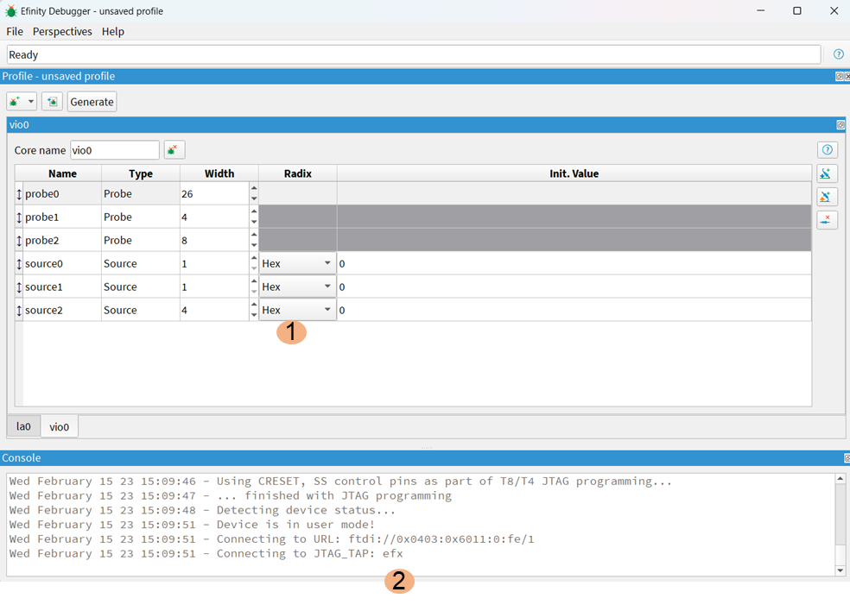
Debug Perspective: Virtual I/O
When you close the Debugger, it asks you if you want to save settings. Click Yes if you want to save values you have entered (such as trigger values, radix, window depth,etc.). This feature lets you open and close the Debugger without losing your work.

Slide 33
Debug Perspective: Virtual I/O
The Debugger provides basic error checking. When you program the FPGA, the Debugger. Checks to make sure that the bitstream you chose matches the FPGA you are trying to program.
Additionally, the Debugger verifies that the debug profile in your Efinity Project matches the debug core in the bitstream you are using. If the Debugger finds any mismatches, it gives an error message.

Slide 34
Debug Perspective: Virtual I/O
Enter values for the sources and observe the values for the probes.
The Console shows messages.

Slide 35
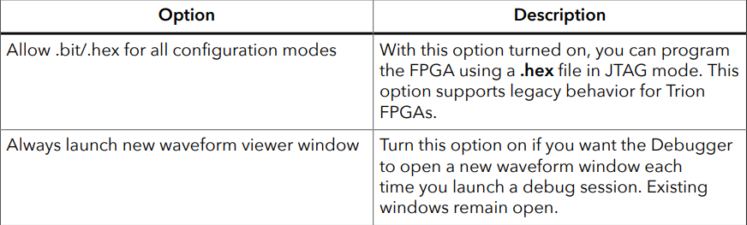
Debugger Options
The Debugger has these options, which you turn on or off in the Options menu:

Slide 36
Concurrent Debugging
The Debugger has the concurrent debug feature where you can open multiple debug windows and connect to different JTAG USER TAP interfaces at the same time. This feature lets you perform debugging more easily.
This feature is supported in the Efinity software v2022.1 and higher.
The concurrent debug feature requires you to connect to the board using the Efinity Hardware Server. You can use the same computer for the server and client.
Launch the server with the board connected to your computer and then connect to the server from the Debugger client using the same IP address.

Slide 37
Concurrent Debugging
To open more than one Debugger window:
Open the first Debugger window using the Efinity GUI as you normally would.
Open the second Debugger window by executing the following command in a terminal or command prompt:
Windows:
Linux:
<Efinity path>\debugger\bin\efinity_dgb.bat
<Efinity path>/debugger/bin/efinity_dgb.sh

Slide 38
Resource Usage
In Efinity version 2022.1 and higher, you can view the resources used by the debug cores in the Dashboard's Results pane in the Debugger table. The software reports:
Whether auto-instantiation is turned on or off
Whether the debug target is the elaborated or post-map netlist
Number of flipflops used
Number of adders used
Number of LUTs used
Number of memory blocks used

Slide 39
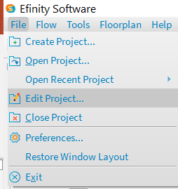
Disable the Debug Core
If you want to remove a debug core from your project:
Open the Project Editor.

Slide 40
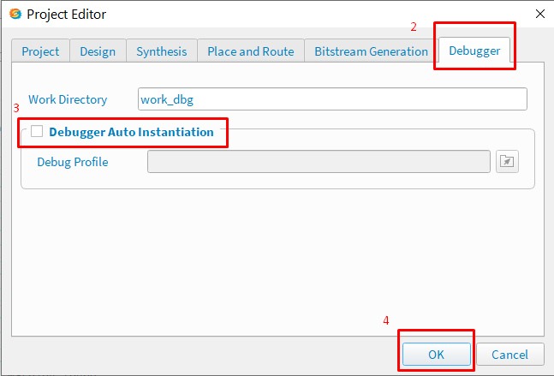
Disable the Debug Core
Click the Debugger tab.
Turn off the Debugger Auto Instantiation option.
Click OK.
Re-compile the design
The software removes the debug profile from your design but does not remove it from disk. So, you can re-enable the debug profile again by turning on the Debugger Auto Instantiation, specifying the profile name, and recompiling.

